Slide 1
Is there evidence for a peak in this data?

Slide 2
Is there evidence for a peak in this data?
“Observation of an Exotic S=+1
Baryon in Exclusive Photoproduction from the Deuteron”
S. Stepanyan et al, CLAS Collab, Phys.Rev.Lett. 91 (2003) 252001
“The statistical significance of the peak is 5.2 ± 0.6 σ”

Slide 3
Is there evidence for a peak in this data?
“Observation of an Exotic S=+1
Baryon in Exclusive Photoproduction from the Deuteron”
S. Stepanyan et al, CLAS Collab, Phys.Rev.Lett. 91 (2003) 252001
“The statistical significance of the peak is 5.2 ± 0.6 σ”
“A Bayesian analysis of pentaquark signals from CLAS data”
D. G. Ireland et al, CLAS Collab, Phys. Rev. Lett. 100, 052001 (2008)
“The ln(RE) value for g2a (-0.408) indicates weak evidence in favour of the data model without a peak in the spectrum.”
Comment on “Bayesian Analysis of Pentaquark Signals from CLAS Data” Bob Cousins, http://arxiv.org/abs/0807.1330

Slide 4
Statistical Issues in Searches for New Physics
Louis Lyons
Imperial College, London
and
Oxford
Birmingham
Feb 2016

Slide 5
Theme: Using data to make judgements about H1 (New Physics) versus
H0 (S.M. with nothing new)
Why?
Experiments are expensive and time-consuming
so
Worth investing effort in statistical analysis
→ better information from data
Topics:
Blind Analysis
LEE = Look Elsewhere Effect
Why 5σ for discovery?
Significance
P(A|B) ≠ P(B|A)
Meaning of p-values
Wilks’ Theorem
Background Systematics
Coverage
p₀ v p₁ plots
Higgs search: Discovery and spin
(N.B. Several of these topics have no unique solutions from Statisticians)
Conclusions

Slide 6
Choosing between 2 hypotheses
Hypothesis testing: New particle or statistical fluctuation?
H0 = b H1 = b + s

Slide 7
Choosing between 2 hypotheses
Possible methods:
Δχ²
p-value of statistic →
lnL–ratio
Bayesian:
Posterior odds
Bayes factor
Bayes information criterion (BIC)
Akaike …….. (AIC)
Minimise “cost”
See ‘Comparing two hypotheses’
http://www-cdf.fnal.gov/physics/statistics/notes/H0H1.pdf

Slide 8
(a) (b)
H0 H1
t_{obs}
t
t_{obs}
t
p₁ p₀
With 2 hypotheses, each with own pdf, p-values are defined as tail areas, pointing in towards each other
(c)
H0 H1
t_{obs}
t

Slide 9
Procedure for choosing between 2 hypotheses
1) No sensitivity 2) Maybe 3) Easy separation
H0 H1
t
β t_{crit} α
Procedure: Obtain expected distributions for data statistic (e.g. L-ratio) for H0 and H1
Choose α (e.g. 95%, 3σ, 5σ ?) and CL for p₁ (e.g. 95%)
Given b, α determines t_{crit}
b+s defines β. For s > s_{min}, separation of curves → discovery or excln
1-β = Power of test
Now data: If t_{obs} ≥ t_{crit} (i.e. p₀ ≤ α), discovery at level α
If t_{obs} < t_{crit}, no discovery. If p₁ < 1– CL, exclude H1

Slide 10
BLIND ANALYSES
Why blind analysis? Data statistic, selections, corrections, method
Methods of blinding
Add random number to result *
Study procedure with simulation only
Look at only first fraction of data
Keep the signal box closed
Keep MC parameters hidden
Keep unknown fraction visible for each bin
Disadvantages
Takes longer time
Usually not available for searches for unknown
After analysis is unblinded, don’t change anything unless ……..
* Luis Alvarez suggestion re “discovery” of free quarks

Slide 11
Look Elsewhere Effect (LEE)
Prob of bgd fluctuation at that place = local p-value
Prob of bgd fluctuation ‘anywhere’ = global p-value
Global p > Local p
Where is `anywhere’?
Any location in this histogram in sensible range
Any location in this histogram
Also in histogram produced with different cuts, binning, etc.
Also in other plausible histograms for this analysis
Also in other searches in this PHYSICS group (e.g. SUSY at CMS)
In any search in this experiment (e.g. CMS)
In all CERN expts (e.g. LHC expts + NA62 + OPERA + ASACUSA + ….)
In all HEP expts
etc.
d) relevant for graduate student doing analysis
f) relevant for experiment’s Spokesperson
INFORMAL CONSENSUS:
Quote local p, and global p according to a) above.
Explain which global p

Slide 12
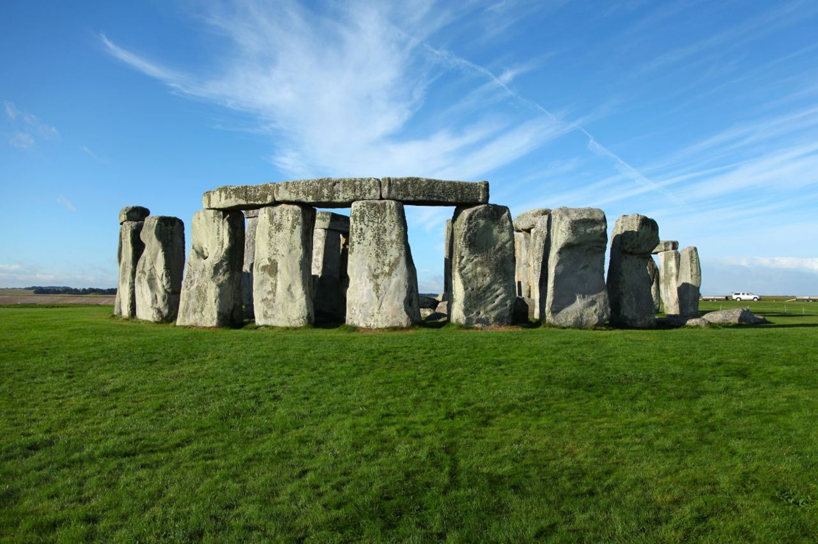
Example of LEE: Stonehenge

Slide 13
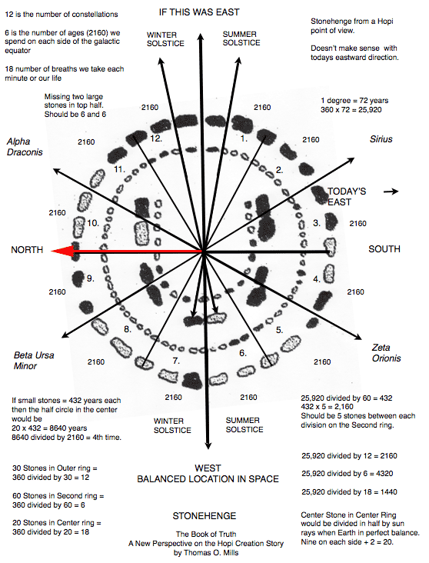

Slide 14
Are alignments significant?
Atkinson replied with his article "Moonshine on Stonehenge" in Antiquity in 1966, pointing out that some of the pits which ….. had used for his sight lines were more likely to have been natural depressions, and that he had allowed a margin of error of up to 2 degrees in his alignments. Atkinson found that the probability of so many alignments being visible from 165 points to be close to 0.5 rather that the "one in a million" possibility which ….. had claimed.
….. had been examining stone circles since the 1950s in search of astronomical alignments and the megalithic yard. It was not until 1973 that he turned his attention to Stonehenge. He chose to ignore alignments between features within the monument, considering them to be too close together to be reliable. He looked for landscape features that could have marked lunar and solar events. However, one of …..'s key sites, Peter's Mound, turned out to be a twentieth-century rubbish dump.

Slide 15
Why 5σ for Discovery?
Statisticians ridicule our belief in extreme tails (esp. for systematics)
Our reasons:
1) Past history (Many 3σ and 4σ effects have gone away)
2) LEE (see later)
3) Worries about underestimated systematics
4) Subconscious Bayes calculation
p(H₁|x) = p(x|H₁) * π(H₁)
p(H₀|x) p(x|H₀) π(H₀)
Posterior Likelihood Priors
prob ratio
“Extraordinary claims require extraordinary evidence”
N.B. Points 2), 3) and 4) are experiment-dependent
Alternative suggestion:
L.L. “Discovering the significance of 5σ” http://arxiv.org/abs/1310.1284

Slide 16
How many σ’s for discovery?
SEARCH | SURPRISE | IMPACT | LEE | SYSTEMATICS | No. σ
Higgs search | Medium | Very high | M | Medium | 5
Single top | No | Low | No | No | 3
SUSY | Yes | Very high | Very large | Yes | 7
B_{s} oscillations | Medium/Low | Medium | Δm | No | 4
Neutrino osc | Medium | High | sin²2ϑ, Δm² | No | 4
B_{s}→ μ μ | No | Low/Medium | No | Medium | 3
Pentaquark | Yes | High/V. high | M, decay mode | Medium | 7
(g-2)_{μ} anom | Yes | High | No | Yes | 4
H spin ≠ 0 | Yes | High | No | Medium | 5
4th gen q, l, ν | Yes | High | M, mode | No | 6
Dark energy | Yes | Very high | Strength | Yes | 5
Grav Waves | No | High | Enormous | Yes | 8
Suggestions to provoke discussion, rather than `delivered on Mt. Sinai’
Bob Cousins: “2 independent expts each with 3.5σ better than one expt with 5σ”

Slide 17
Significance
Significance = S/√B or similar ?
Potential Problems:
Uncertainty in B
Non-Gaussian behaviour of Poisson, especially in tail
Number of bins in histogram, no. of other histograms [LEE]
Choice of cuts, bins (Blind analyses)
For future experiments:
Optimising: Could give S =0.1, B = 10⁻⁴, S/√B =10

Slide 18
P(A|B) ≠ P(B|A)
Remind Lab or University media contact person that:
Prob[data, given H0] is very small
does not imply that
Prob[H0, given data] is also very small.
e.g. Prob{data | speed of ν ≤ c}= very small
does not imply
Prob{speed of ν≤c | data} = very small
or Prob{speed of ν>c | data} ~ 1
Everyday situation, 2nd most convincing example:
Pack of playing cards
p(spade|king) = 1/4
p(king|spade) = 1/13

Slide 19
P(A|B) ≠ P(B|A)
Remind Lab or University media contact person that:
Prob[data, given H0] is very small
does not imply that
Prob[H0, given data] is also very small.
e.g. Prob{data | speed of ν ≤ c}= very small
does not imply
Prob{speed of ν≤c | data} = very small
or Prob{speed of ν>c | data} ~ 1
Everyday example p(pregnant|female) ~ 3%
p(female|pregnant) >> 3%

Slide 20
What p-values are (and are not)
H0 pdf
p₀ = α
Reject H0 if t > t_{crit} (p < α )
p-value = prob that t ≥ t_{obs}
Small p → data and theory have poor compatibility
Small p-value does NOT automatically imply that theory is unlikely
Bayes prob(Theory|data) related to prob(data|Theory) = Likelihood
by Bayes Th, including Bayesian prior
p-values are misunderstood. e.g. Anti-HEP jibe:
“Particle Physicists don’t know what they are doing, because half their
p ˂ 0.05 exclusions turn out to be wrong”
Demonstrates lack of understanding of p-values
[All results rejecting energy conservation with p ˂α =.05 cut will turn out to be ‘wrong’]
t_{crit} t

Slide 21
Combining different p-values
Several results quote independent p-values for same effect:
p₁, p₂, p₃….. e.g. 0.9, 0.001, 0.3 ……..
What is combined significance? Not just p_{1*}p_{2*}p₃…..
If 10 expts each have p ~ 0.5, product ~ 0.001 and is clearly NOT correct combined p
S = z * (-ln z)^{j} /j! , z = p₁p₂p₃…….
(e.g. For 2 measurements, S = z * (1 - lnz) ≥ z )
Problems:
1) Recipe is not unique (Uniform dist in n-D hypercube → uniform in 1-D)
2) Formula is not associative
Combining {{p₁ and p₂}, and then p₃} gives different answer
from {{p₃ and p₂}, and then p₁} , or all together
Due to different options for “more extreme than x₁, x₂, x₃”.
3) Small p’s due to different discrepancies
******* Better to combine data ************

Slide 22
Wilks’ Theorem
Data = some distribution e.g. mass histogram
For H0 and H1, calculate best fit weighted sum of squares S₀ and S₁
Examples: 1) H0 = polynomial of degree 3
H1 = polynomial of degree 5
2) H0 = background only
H1 = bgd+peak with free M₀ and cross-section
3) H0 = normal neutrino hierarchy
H1 = inverted hierarchy
If H0 true, S₀ distributed as χ² with ndf = ν₀
If H1 true, S₁ distributed as χ² with ndf = ν₁
If H0 true, what is distribution of ΔS = S₀ – S₁? Expect not large. Is it χ²?
Wilks’ Theorem: ΔS distributed as χ² with ndf = ν₀ – ν₁ provided:
H0 is true
H0 and H1 are nested
Params for H1→ H0 are well defined, and not on boundary
Data is asymptotic
.

Slide 23
Wilks’ Theorem, contd
Examples: Does Wilks’ Th apply?
1) H0 = polynomial of degree 3
H1 = polynomial of degree 5
YES: ΔS distributed as χ² with ndf = (d-4) – (d-6) = 2
2) H0 = background only
H1 = bgd + peak with free M₀ and cross-section
NO: H0 and H1 nested, but M₀ undefined when H1→ H0. ΔS≠χ²
(but not too serious for fixed M)
3) H0 = normal neutrino hierarchy
H1 = inverted hierarchy
NO: Not nested. ΔS≠χ² (e.g. can have Δχ² negative)
N.B. 1: Even when W. Th. does not apply, it does not mean that ΔS
is irrelevant, but you cannot use W. Th. for its expected distribution.
N.B. 2: For large ndf, better to use ΔS, rather than S₁ and S₀ separately

Slide 24
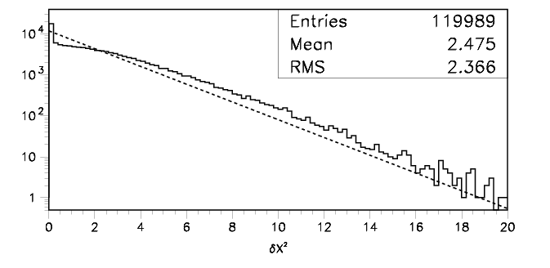
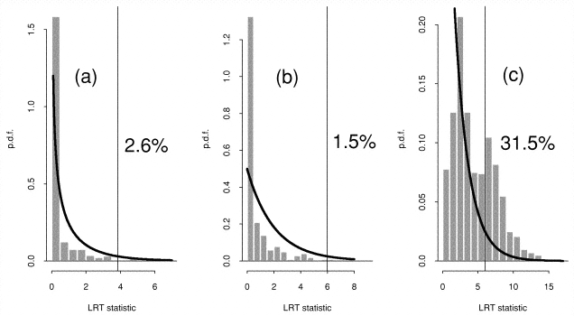
Is difference in S distributed as χ² ?
Demortier:
H0 = quadratic bgd
H1 = ……………… +
Gaussian of fixed width,
variable location & ampl
What is peak at zero?
Why not half the entries?
Protassov, van Dyk, Connors, ….
H0 = continuum
H1 = narrow emission line
H1 = wider emission line
H1 = absorption line
Nominal significance level = 5%

Slide 25
Is difference in S distributed as χ² ?, contd.
So need to determine the ΔS distribution by Monte Carlo
N.B.
For mass spectrum, determining ΔS for hypothesis H1 when data is generated according to H0 is not trivial, because there will be lots of local minima
If we are interested in 5σ significance level, needs lots of MC simulations (or intelligent MC generation)
Asymptotic formulae may be useful (see K. Cranmer, G. Cowan, E. Gross and O. Vitells, 'Asymptotic formulae for likelihood-based tests of new physics', http://link.springer.com/article/10.1140%2Fepjc%2Fs10052-011-1554-0 )

Slide 26
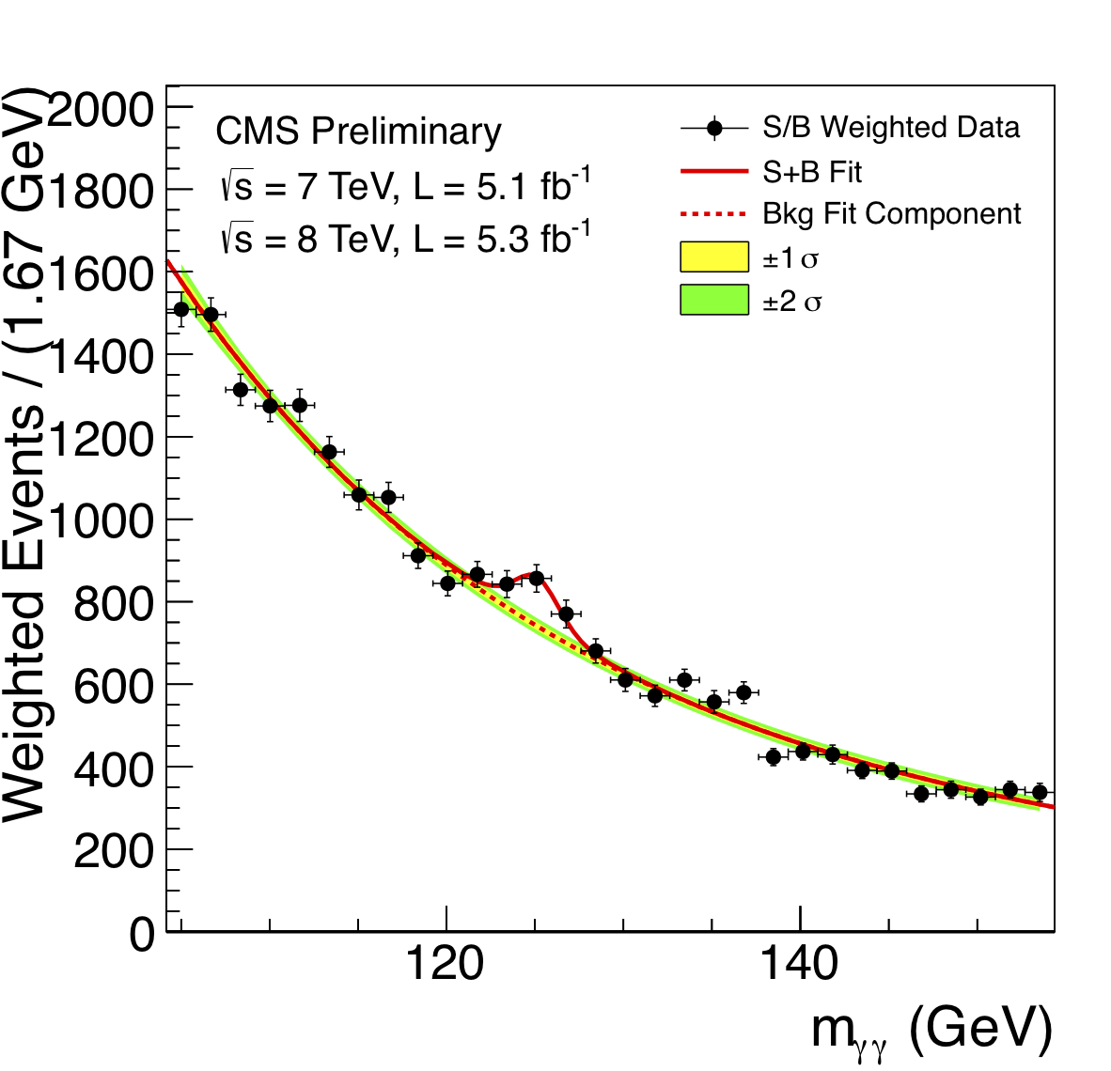
Background systematics

Slide 27
Background systematics, contd
Signif from comparing χ²’s for H0 (bgd only) and for H1 (bgd + signal)
Typically, bgd = functional form f_{a} with free params
e.g. 4th order polynomial
Uncertainties in params included in signif calculation
But what if functional form is different ? e.g. f_{b}
Typical approach:
If f_{b} best fit is bad, not relevant for systematics
If f_{b} best fit is ~comparable to f_{a} fit, include contribution to systematics
But what is ‘~comparable’?
Other approaches:
Profile likelihood over different bgd parametric forms
http://arxiv.org/pdf/1408.6865v1.pdf?
Background subtraction
sPlots
Non-parametric background
Bayes
etc
No common consensus yet among experiments on best approach
{Spectra with multiple peaks are more difficult}

Slide 28
“Handling uncertainties in background shapes: the discrete profiling method”
Dauncey, Kenzie, Wardle and Davies (Imperial College, CMS)
arXiv:1408.6865v1 [physics.data-an]
Has been used in CMS analysis of H→γγ
Problem with ‘Typical approach’: Alternative functional forms do or don’t contribute to systematics by hard cut, so systematics can change discontinuously wrt ∆χ²
Method is like profile L for continuous nuisance params
Here ‘profile’ over discrete functional forms

Slide 29

Reminder of Profile L
υ
Stat uncertainty on s from width of L fixed at υ_{best}
Total uncertainty on s from width of L(s,υ_{prof(s)}) = L_{prof}
υ_{prof(s)} is best value of υ at that s
υ_{prof(s)} as fn of s lies on green line
Total uncert ≥ stat uncertainty
s
Contours of lnL(s,υ)
s = physics param
υ = nuisance param

Slide 30
-2lnL
∆
s

Slide 31
Red curve: Best value of nuisance param υ
Blue curves: Other values of υ
Horizontal line: Intersection with red curve→
statistical uncertainty
‘Typical approach’: Decide which blue curves have small enough ∆
Systematic is largest change in minima wrt red curves’.
Profile L: Envelope of lots of blue curves
Wider than red curve, because of systematics (υ)
For L = multi-D Gaussian, agrees with ‘Typical approach’
Dauncey et al use envelope of finite number of functional forms

Slide 32
Point of controversy!
Two types of ‘other functions’:
Different function types e.g.
Σa_{i} x_{i} versus Σa_{i}/x_{i}
b) Given fn form but different number of terms
DDKW deal with b) by -2lnL → -2lnL + kn
n = number of extra free params wrt best
k = 1, as in AIC (= Akaike Information Criterion)
Opposition claim choice k=1 is arbitrary.
DDKW agree but have studied different values, and say k =1 is optimal for them.
Also, any parametric method needs to make such a choice

Slide 33
Example of misleading inference
Ofer Vitells, Weizmann Institute PhD thesis (2014)
On-off problem (signal + bgd, bgd only)
e.g. n_{on} = 10, m_{off} = 0
i.e. convincing evidence for signal
Now, to improve analysis, look at spectra of events (e.g. in mass) in “on” and “off” regions
e.g. Use 100 narrow bins → n_{i} = 1 for 10 bins, m_{i} = 0 for all bins
Assume bins are chosen so that signal expectation s_{i} is uniform in all bins
but bgd b_{i} is unknown

Slide 34
Likelihood: L(s,b_{i}) = e^{–Ks} e^{–(1+τ)Σbi} Π_{j}(s+b_{j})
K = number of bins (e.g. 100)
τ = scale factor for bgd (e.g. 1)
j = “on” bins with event (e.g. 1….. 10)
Profile over background nuisance params b_{i}
L_{prof}(s) has largest value at
s=0 if n_{on} < K/(1+τ)
s=n_{on}/K if n_{on} ≥ K/(1+τ)
Similar result for Bayesian marginalisation of L(s,b_{i}) over backgrounds b_{i}
i.e. With many bins, profile (or marginalised) L has largest value at s=0,
even though n_{on} = 10 and m_{off}=0
BUT when mass distribution ignored (i.e. just counting experiment),
signal+bgd is favoured over just bgd

Slide 35
WHY?
Background given greater freedom with large number K of nuisance parameters
Compare:
Neyman and Scott, “Consistent estimates based on partially
consistent observations”, Econometrica 16: 1-32 (1948)
Data = n pairs X_{1i} = G(µ_{i}, σ²)
X_{2i} = G(µ_{i}, σ²)
Param of interest = σ²
Nuisance params = µ_{i}. Number increases with n
Profile L estimate of σ² are biassed E = σ²/2
and inconsistent (bias does not tend to 0 as n → ∞)
MORAL: Beware!

Slide 36
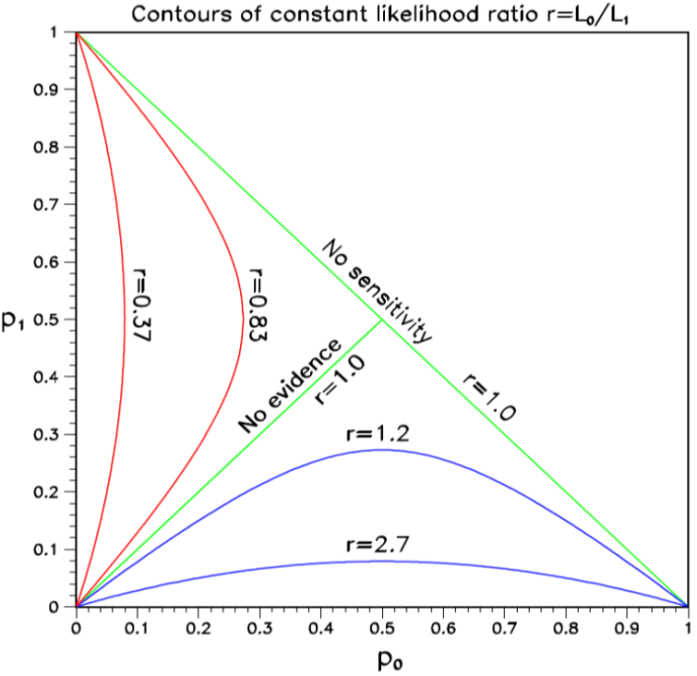
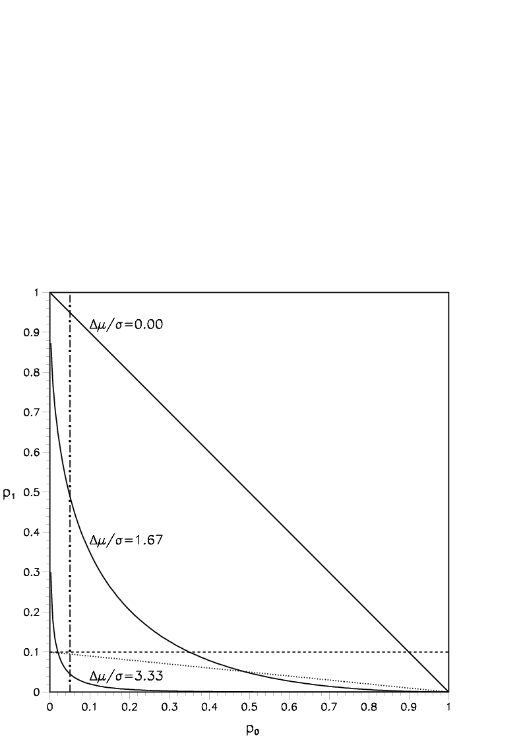
p₀ v p₁ plots
Preprint by Luc Demortier and LL,
“Testing Hypotheses in Particle Physics: Plots of p₀ versus p₁”
http://arxiv.org/abs/1408.6123
For hypotheses H0 and H1, p₀ and p₁ are the tail probabilities for data statistic t
Provide insights on:
CLs for exclusion
Punzi definition of sensitivity
Relation of p-values and Likelihoods
Probability of misleading evidence
Sampling to foregone conclusion
Jeffreys-Lindley paradox

Slide 37
CLs = p₁/(1-p₀) → diagonal line
Provides protection against excluding H₁ when little or no sensitivity
Punzi definition of sensitivity:
Enough separation of pdf’s for no chance of ambiguity
Δµ
H₀ H₁
t
Can read off power of test
e.g. If H₀ is true, what is prob of rejecting H₁?
N.B. p₀ = tail towards H₁
p₁ = tail towards H₀

Slide 38
Why p ≠ Likelihood ratio
Measure different things:
p₀ refers just to H0; L₀₁ compares H0 and H1
Depends on amount of data:
e.g. Poisson counting expt little data:
For H0, μ₀ = 1.0. For H1, μ₁ =10.0
Observe n = 10 p₀ ~ 10⁻⁷ L₀₁ ~10⁻⁵
Now with 100 times as much data, μ₀ = 100.0 μ₁ =1000.0
Observe n = 160 p₀ ~ 10⁻⁷ L₀₁ ~10⁺¹⁴

Slide 39
Jeffreys-Lindley Paradox
H0 = simple, H1 has μ free
p₀ can favour H₁, while B₀₁ can favour H₀
B₀₁ = L₀ / ∫L₁(s) π(s) ds
Likelihood ratio depends on signal :
e.g. Poisson counting expt small signal s:
For H₀, μ₀ = 1.0. For H₁, μ₁ =10.0
Observe n = 10 p₀ ~ 10⁻⁷ L₀₁ ~10⁻⁵ and favours H₁
Now with 100 times as much signal s, μ₀ = 100.0 μ₁ =1000.0
Observe n = 160 p₀ ~ 10⁻⁷ L₀₁ ~10⁺¹⁴ and favours H₀
B₀₁ involves intergration over s in denominator, so a wide enough range
will result in favouring H₀
However, for B₀₁ to favour H₀ when p₀ is equivalent to 5σ, integration
range for s has to be O(10⁶) times Gaussian widths

Slide 40
WHY LIMITS?
Michelson-Morley experiment → death of aether
HEP experiments: If UL on expected rate for new particle < expected, exclude particle
CERN CLW (Jan 2000)
FNAL CLW (March 2000)
Heinrich, PHYSTAT-LHC, “Review of Banff Challenge”

Slide 41
Methods (no systematics)
Bayes (needs priors e.g. const, 1/μ, 1/√μ, μ, …..)
Frequentist (needs ordering rule,
possible empty intervals, F-C)
Likelihood (DON’T integrate your L)
χ² (σ² =μ)
χ²(σ² = n)
Recommendation 7 from CERN CLW: “Show your L”
1) Not always practical
2) Not sufficient for frequentist methods

Slide 42
Ilya Narsky, FNAL CLW 2000

Slide 43
DESIRABLE PROPERTIES
Coverage
Interval length
Behaviour when n < b
Limit increases as σ_{b} increases
Unified with discovery and interval estimation

Slide 44
90% Classical interval for Gaussian
σ = 1 μ ≥ 0 e.g. m²(ν_{e})
X_{obs} = 3 Two-sided range
X_{obs} = 1 Upper limit
X_{obs} =-2 No region for μ

Slide 45
FELDMAN - COUSINS
Wants to avoid empty classical intervals →
Uses “L-ratio ordering principle” to resolve ambiguity about “which 90% region?”
[Neyman + Pearson say L-ratio is best for hypothesis testing]
Unified → No ‘Flip-Flop’ problem

Slide 46
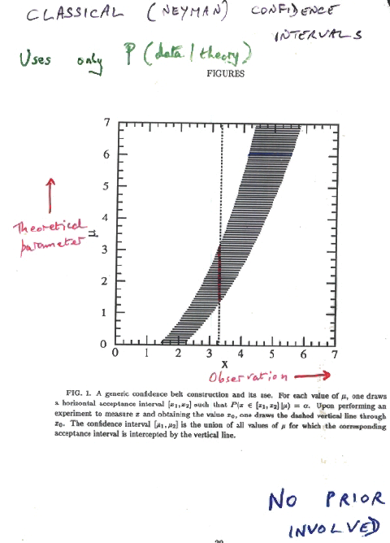
Classical (Neyman) Confidence Intervals
Uses only P(data|theory)
Theoretical Parameter
µ
Data x
Example:
Param = Temp at centre of Sun
Data = Est. flux of solar neutrinos
Prob(µ_{l}<µ<µ_{u}) = α
μ≥0 No prior for μ

Slide 47
Classical (Neyman) Confidence Intervals
Uses only P(data|theory)
Theoretical Parameter
µ
Data x µ range
<1.5 Empty
1.5 – 2.2 Upper limit
>2.2 2-sided
Data x
Example:
Param = Temp at centre of Sun
Data = est. flux of solar neutrinos
μ≥0 No prior for μ

Slide 48
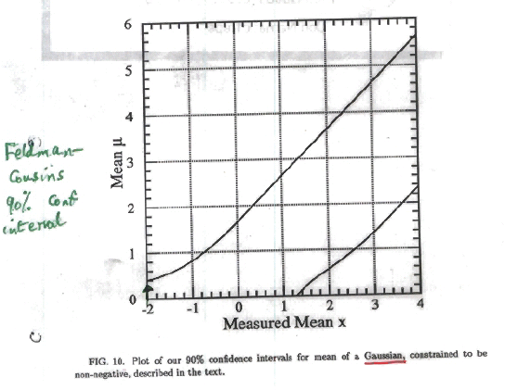
Feldman-Cousins 90% conf intervals
X_{obs} = -2 now gives upper limit
central confidence region

Slide 49
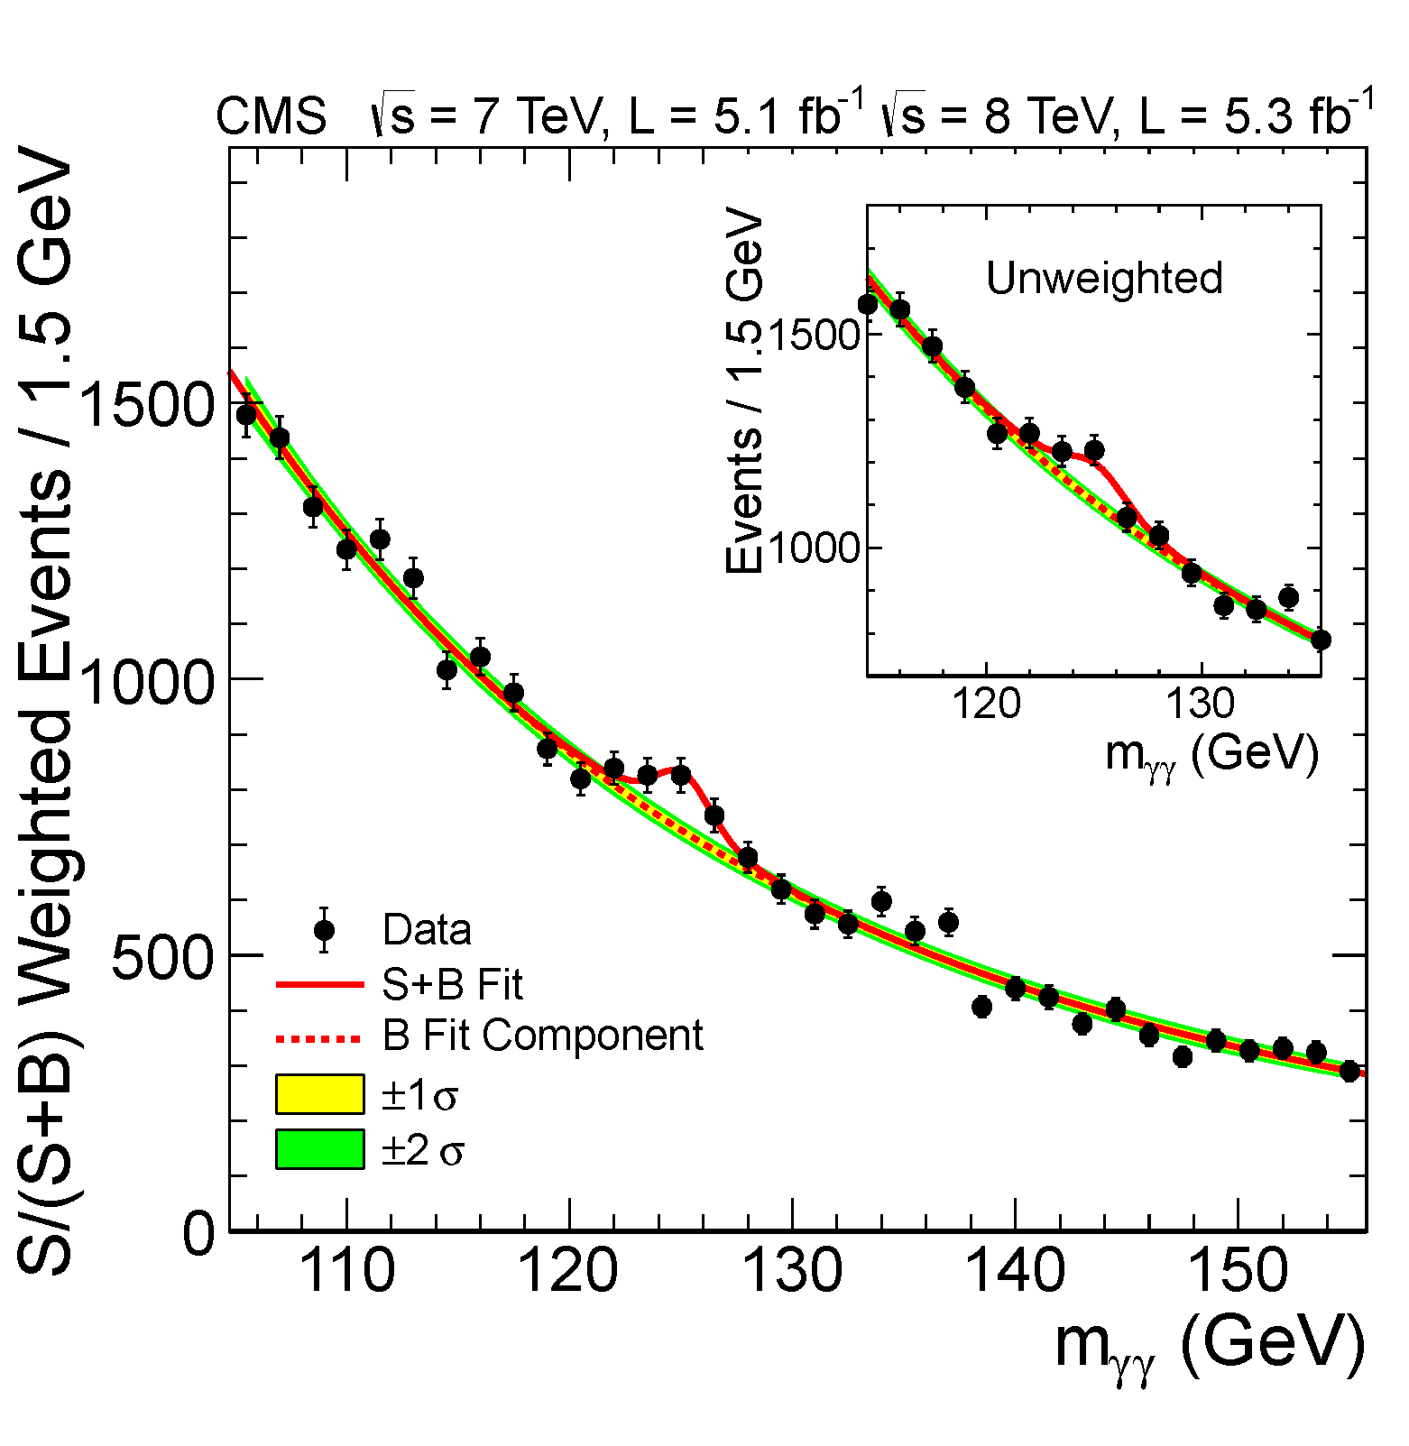
Search for Higgs:
H→ γ γ: low S/B, high statistics

Slide 50
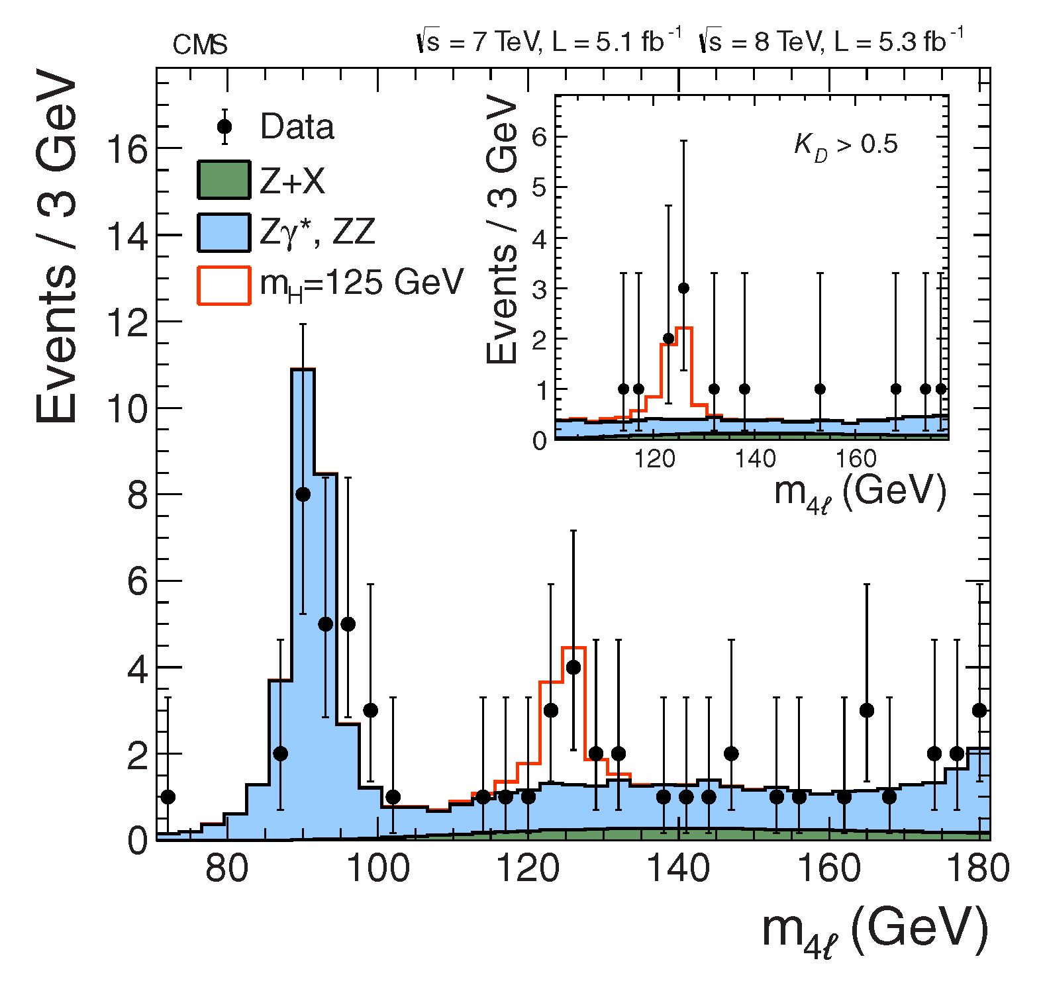
H→Z Z → 4 l: high S/B, low statistics

Slide 51
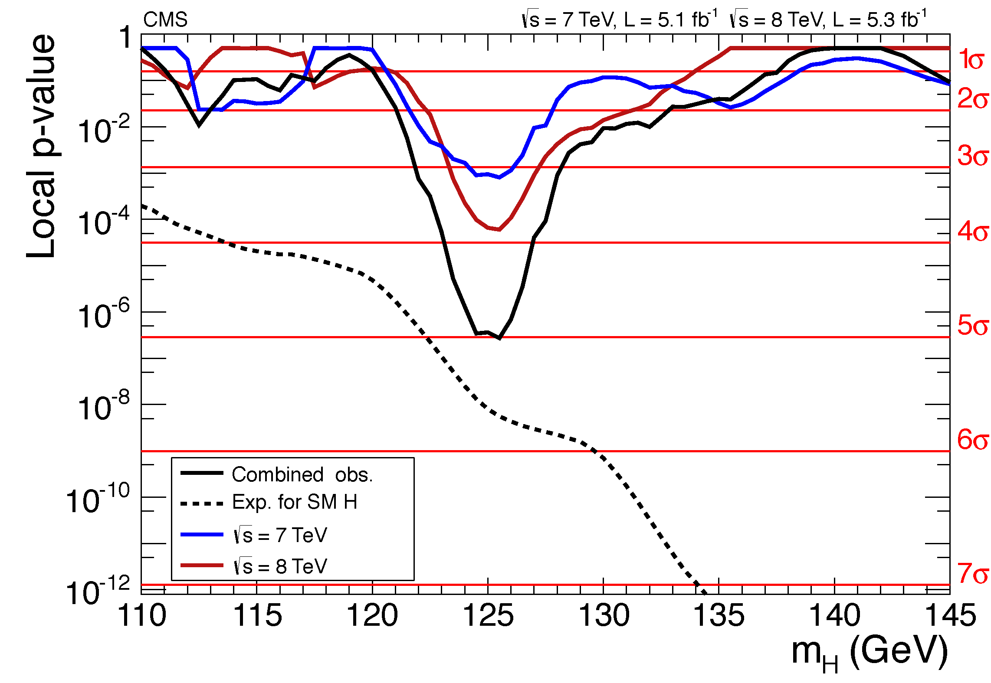
p-value for ‘No Higgs’ versus m_{H}

Slide 52
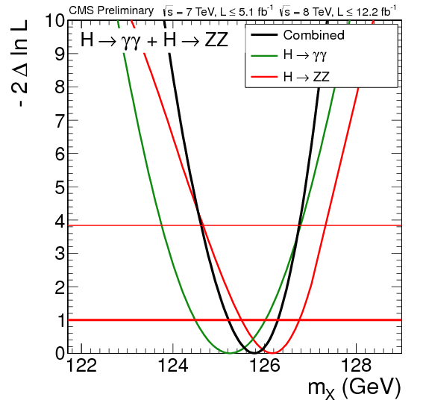
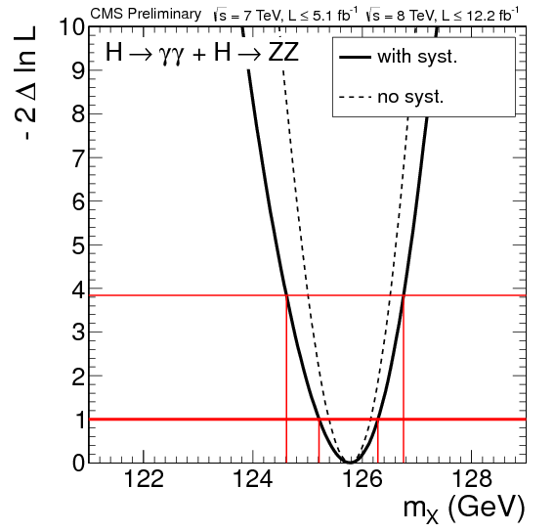
Mass of Higgs:
Likelihood versus mass

Slide 53
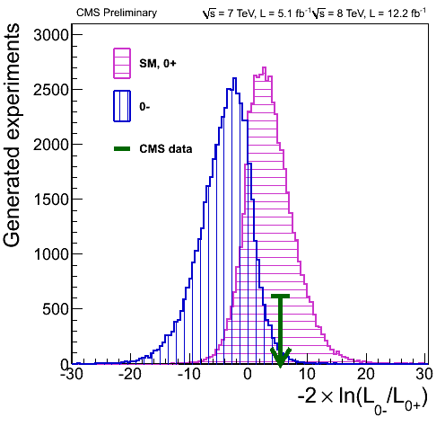
Comparing 0⁺ versus 0⁻ for Higgs
(like Neutrino Mass Hierarchy)
http://cms.web.cern.ch/news/highlights-cms-results-presented-hcp

Slide 54
Conclusions
Resources:
Software exists: e.g. RooStats
Books exist: Barlow, Cowan, James, Lista, Lyons, Roe,…..
New: `Data Analysis in HEP: A Practical Guide to
Statistical Methods’ , Behnke et al.
PDG sections on Prob, Statistics, Monte Carlo
CMS and ATLAS have Statistics Committees (and BaBar and CDF earlier) – see their websites
Before re-inventing the wheel, try to see if Statisticians have already found a solution to your statistics analysis problem.
Don’t use a square wheel if a circular one already exists.
“Good luck”

